Slide 1


University of New Haven- Tagliatela College of Engineering DSCI-6007-03 Distributed & Scalable Data Engineering
Real-Time Sentiment Analysis for Stock Market Prediction Using Big Data & Cloud Computing

Slide 2



MEET THE TEAM
Harshitha Sarabudla Akhil Puttabanthi Yogananda Manjunath

Slide 3


The Business Problem
Stock prices rise and fall based on news and social media. Traditional methods don’t track real-time sentiment, making it hard for investors to act quickly. This can lead to missed opportunities or bad investment decisions.

Slide 4

How to Solve
Collecting data from Twitter and NewsAPI. Real-time sentiment analysis ingestion via Kinesis.
Athena queries sentiment and stock data, enabling efficient analysis of market trends. This helps derive insights for stock price predictions.
AWS Lambda handles data processing and cleaning while applying NLP-based sentiment analysis.
Visual charts and dashboards are created in Amazon QuickSight, helping investors see trends and make better trading decisions.
Raw and processed sentiment data is then securely stored in S3, providing scalable and reliable storage.

Slide 5
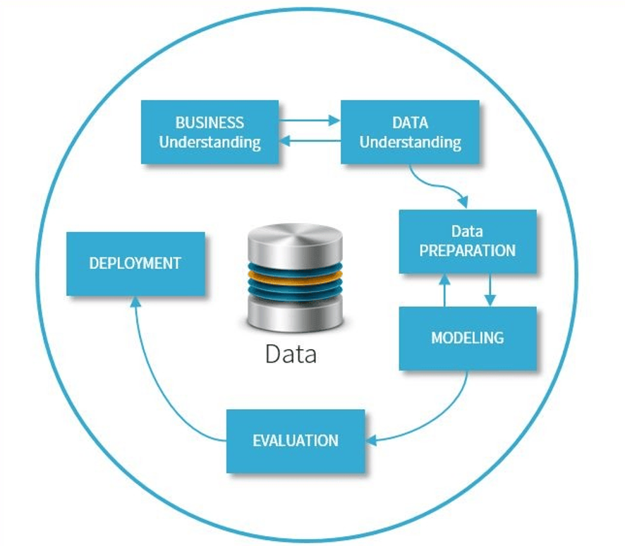
Crisp-DM Methodology

Slide 6
Business Understanding
Objective: To analyze real-time stock market sentiment from news and social media and provide insights to help investors make informed trading decisions
Business Questions:
How can real-time sentiment analysis improve stock market predictions?
What challenges arise in processing and analyzing high-volume financial data?
How can investors use sentiment insights to make better trading decisions?

Slide 7
Data Understanding
1. Types of Data:
Stock Market Data (Numerical): Prices, volume, and trends to track stock movements.
News & Social Media Data (Textual): Financial news and tweets analyzed using NLP for sentiment.
Sentiment Scores (Derived): NLP-generated scores ranging from -1 (negative) to +1 (positive)
2. Data Sources:
Yahoo Finance API: Provides real-time and historical stock prices.News & Social Media Data
Twitter API: Captures social media sentiment on stocks and market trends
NewsAPI: Fetches financial news articles affecting the stock market.

Slide 8

Data Preparation
Data Processing: Real-time and batch data from APIs is ingested via Amazon Kinesis, then cleaned and preprocessed using AWS Lambda.
Sentiment Analysis & Feature Engineering: NLP models extract sentiment scores, and features like trends and volatility indicators are generated for analysis.
Data Storage: Raw and processed data is stored in Amazon S3 in structured formats for efficient querying and analysis.
Kinesis
Lambda
S3

Slide 9
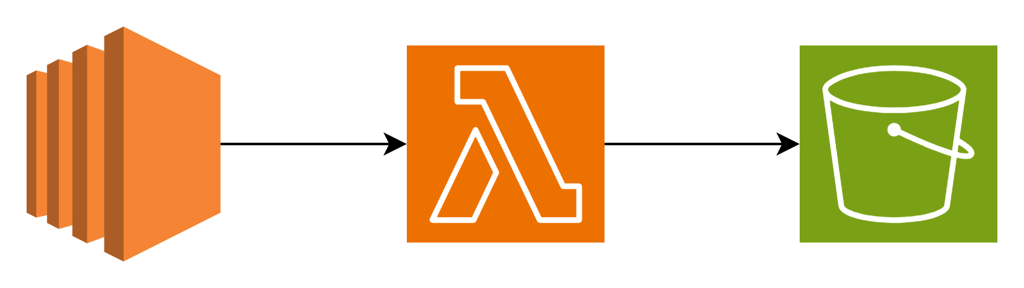
Modelling
Split Data: The dataset is divided into training, validation, and test sets for effective model learning.
Select Features: Key indicators like sentiment scores and stock trends are chosen to enhance predictions.
Train Model: Various models, such as Regression, XGBoost, and LSTMs are tested to determine the best performer.
EC2
Lambda
S3

Slide 10
Evaluation
The model is tested using unseen data to check accuracy.
Metrics like MAE and RMSE measure prediction errors.
Historical stock data is used to validate performance.
EC2 runs evaluations, and S3 stores results.
Athena helps analyze past trends for comparison.

Slide 11
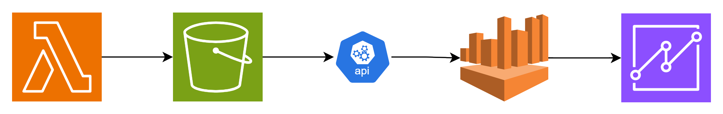
Deployment
The trained model is deployed using AWS Lambda or EC2 for predictions.
Prediction results are stored in S3 for easy access.
API Gateway is used to provide real-time prediction access.
Prediction trends are queried using Amazon Athena.
Stock sentiment insights are visualized with Amazon QuickSight.
API
Gateway
Lambda
S3
Athena
Quick Shift

Slide 12
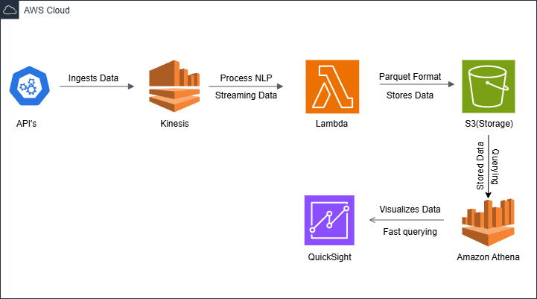
Planned Project Workflow

Slide 13
Conclusion
Stock prices fluctuate based on news and social media, but traditional methods lack real-time sentiment analysis.
Our solution uses AWS and machine learning for real-time sentiment analysis to enable smarter investment decisions.
Built a scalable pipeline to process high-volume data and predict stock movements.
Challenges: Handling real-time data, ensuring sentiment accuracy, and optimizing models
Future goals: Improve model accuracy, integrate deep learning, and expand multi-lingual sentiment analysis.

Slide 14


